Slide 1
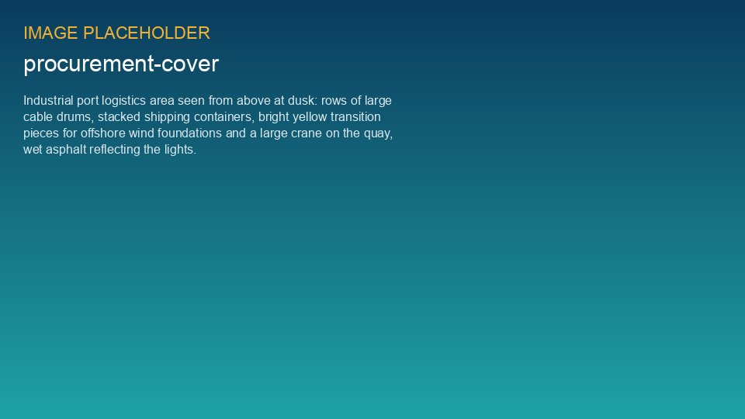
WEYLAND ENERGY
Supply Chain Risk Dashboard
Q3 2026 · Procurement & Supply Chain · for the Executive Board

Slide 2
Q3 at a glance
45
6
1
12
Suppliers in register
Critical suppliers
Supplier under enhanced monitoring
Supply-chain risks (1 red)
• Export cable 2 delay at Severn Subsea Cables is the dominant supply-chain event of 2026
• Lead times for HV equipment still rising
WEYLAND ENERGY · Supply Chain Risk Dashboard Q3 2026
2

Slide 3
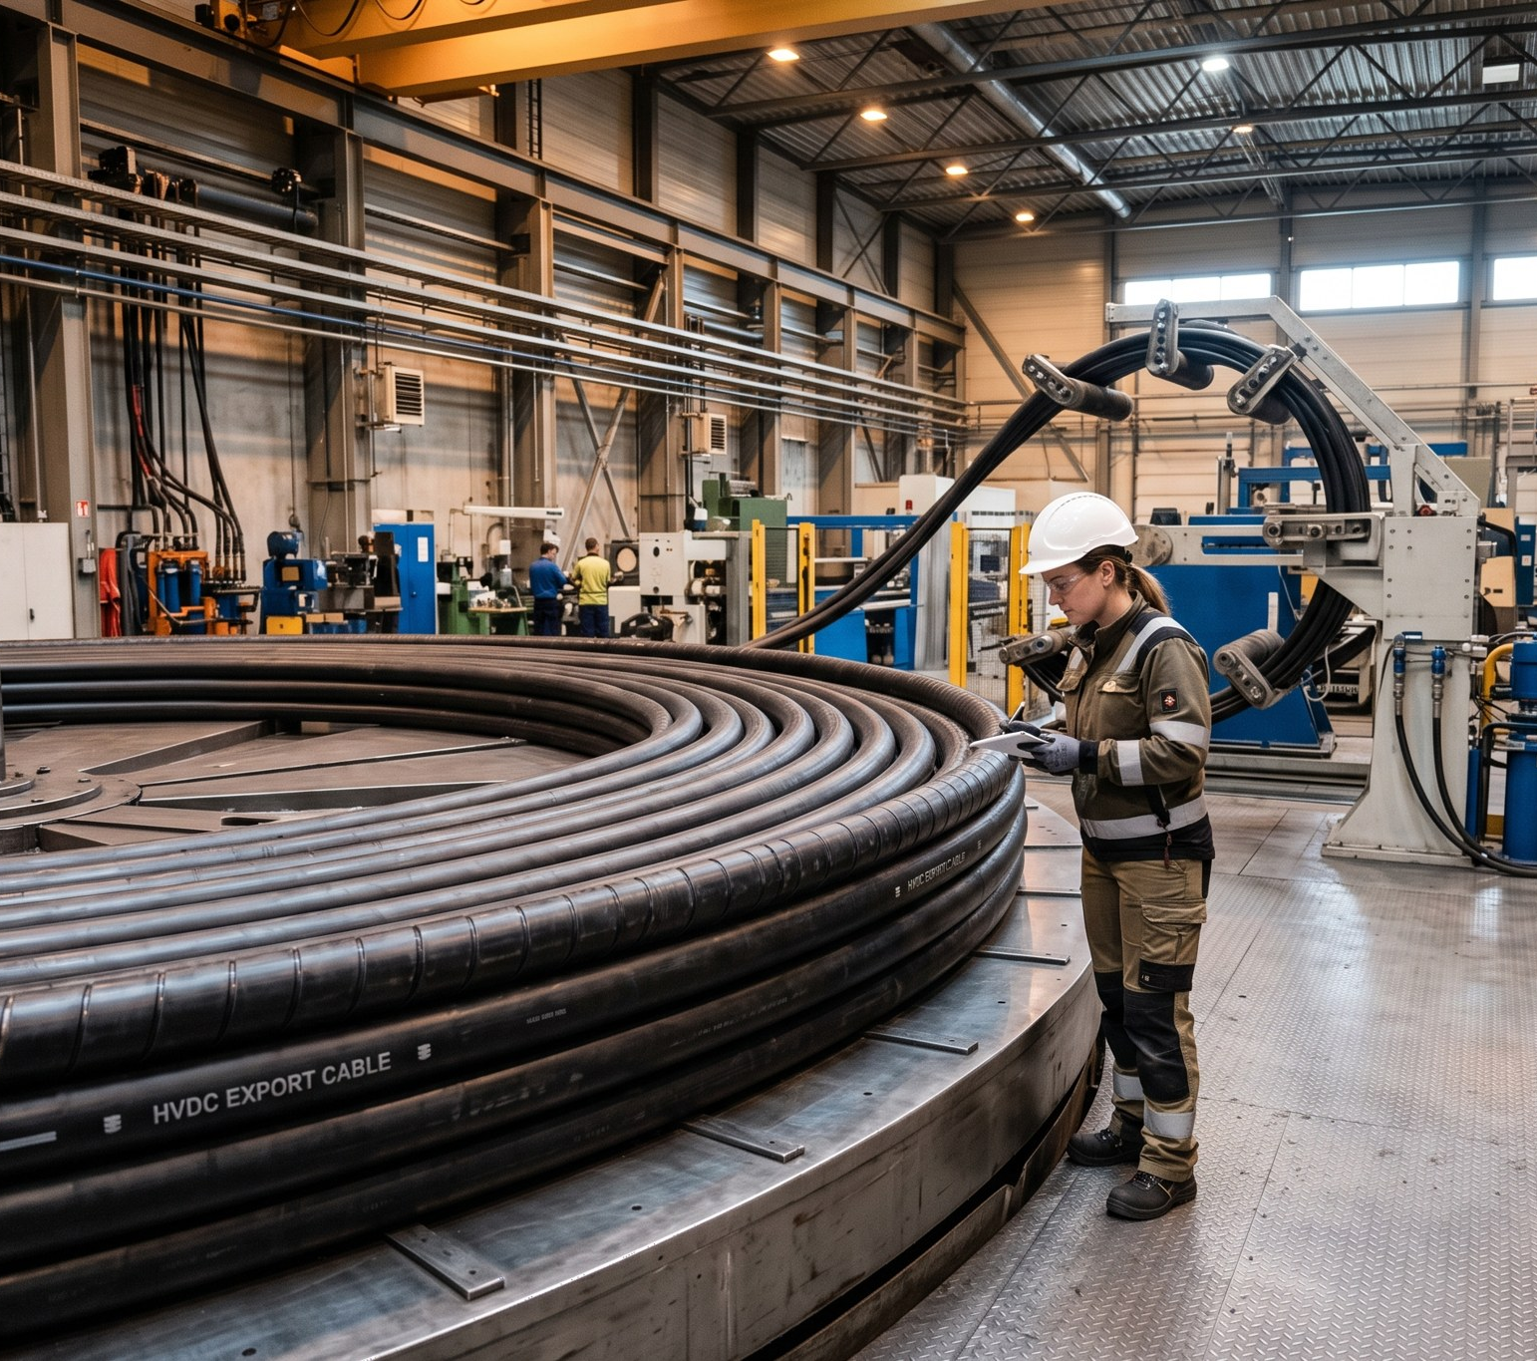
Red risk: export cable 2 – HB-RISK-017
• 21 Jul: factory test failure at Newport, factory joint FJ-2/07
• 9.2 km section re-manufactured; delivery 15 Jan → 12 Mar 2027
• Special audit 11–12 Aug: 1 major finding (clean-room filters) – closed
• Mitigation: resequenced lay campaign, first power unchanged (30 Sep 2027)
• Commercial: LDs reserved under WE-CON-2025-031; CO-010 under negotiation
WEYLAND ENERGY · Supply Chain Risk Dashboard Q3 2026
3
Notes:
Key message for the board: schedule impact contained, commercial position protected. Watch the type test in January.

Slide 4
Risk heat map
Score | Risks
20 (P4 × I5) and above | –
15–16 | SCR-01 cable re-manufacture, SCR-02 transformer lead times
10–12 | SCR-03 monopile single source, SCR-04 jack-up market, SCR-06 polysilicon, SCR-09 port
5–9 | SCR-05, SCR-07, SCR-08 (closed), SCR-10, SCR-12
< 5 | SCR-11
WEYLAND ENERGY · Supply Chain Risk Dashboard Q3 2026
4

Slide 5
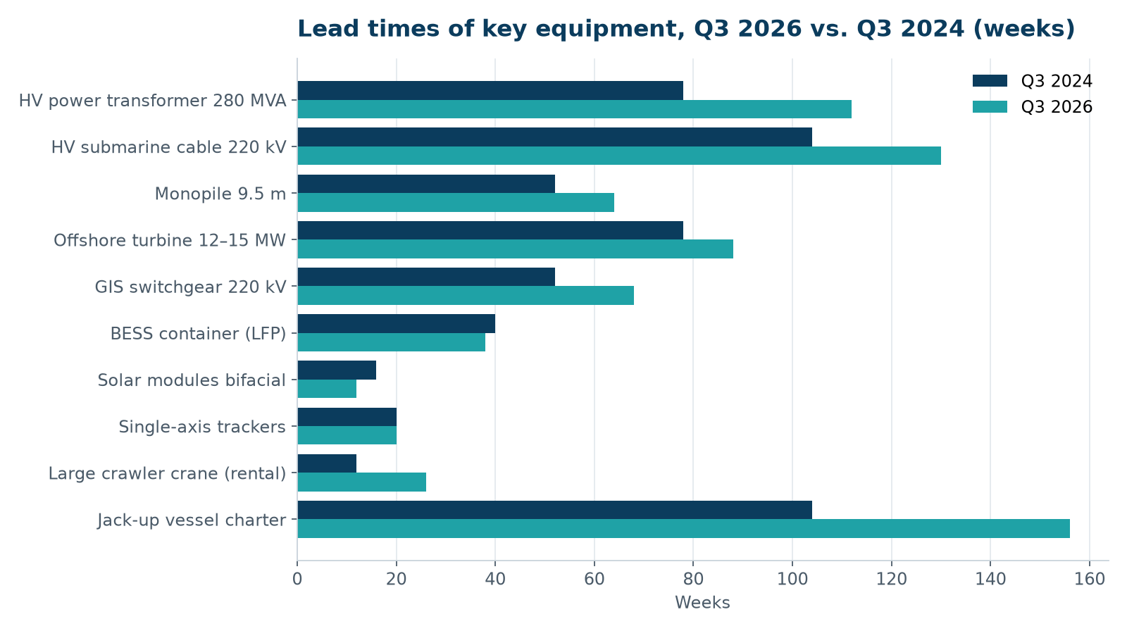
Lead times keep growing
• HV transformers +44 % since 2024
• Jack-up charters booked 3 years ahead
• Solar modules: buyer's market
WEYLAND ENERGY · Supply Chain Risk Dashboard Q3 2026
5

Slide 6
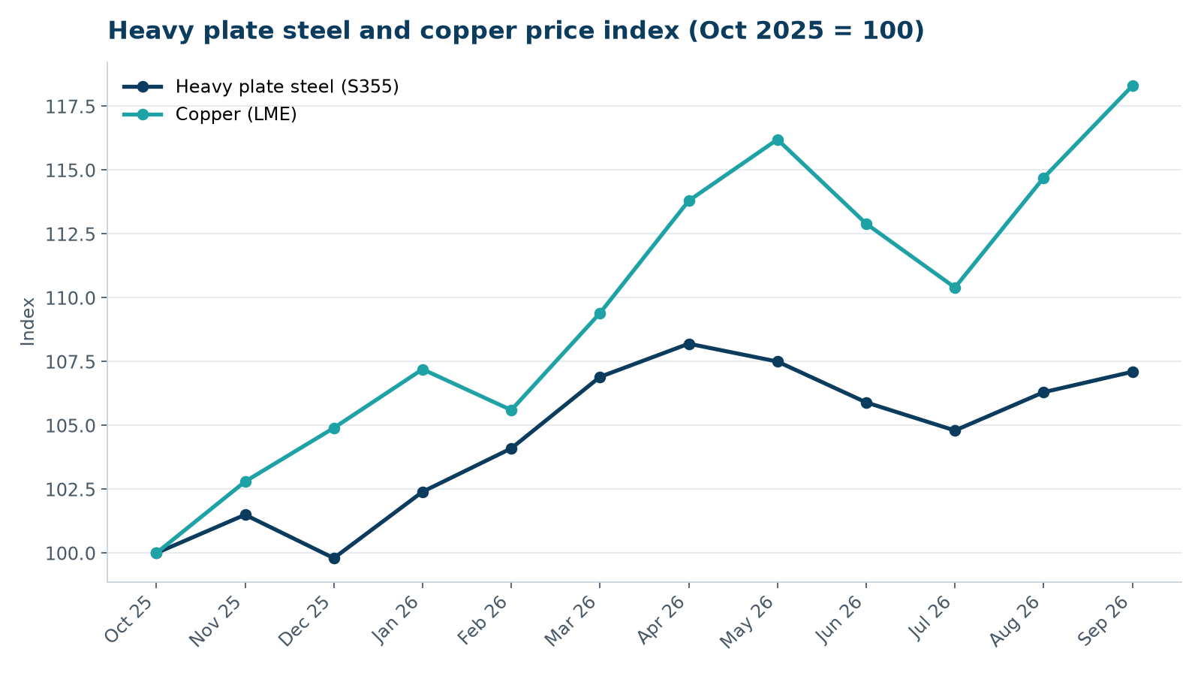
Commodity prices
• Copper +18 % in 12 months
• Major packages fixed price – exposure on variations only
• Fenwick BESS: indexation clause needed
WEYLAND ENERGY · Supply Chain Risk Dashboard Q3 2026
6

Slide 7
Critical supplier status
Supplier | Package | Status | Trend
Halden Turbine Systems | Turbines | On track – production started | →
Rhenus Steelworks | Monopiles/TPs | Batch 5 in transit | →
Severn Subsea Cables | Cables | Enhanced monitoring | ↓
Atlas Marine | MV Sea Atlas | Option 2 exercised | →
Norfab Offshore | HB-OSS | Topside installed 19 Aug | ↑
Port of Eastholm | Port | Quay 3 handed over late | →
WEYLAND ENERGY · Supply Chain Risk Dashboard Q3 2026
7

Slide 8
Actions Q4 2026
• Award CTV contract to Eastholm Workboats (Nov)
• Transformer framework 2027 – RFI in October
• Pre-award audit SunForge EPC (20 Oct)
• LkSG risk analysis 2026 for all direct suppliers (Dec)
• Re-audit Severn after type test (Jan 2027)
WEYLAND ENERGY · Supply Chain Risk Dashboard Q3 2026
8

Slide 9
WEYLAND ENERGY
Questions
Laura Kessler · Procurement Manager

